Slide 1
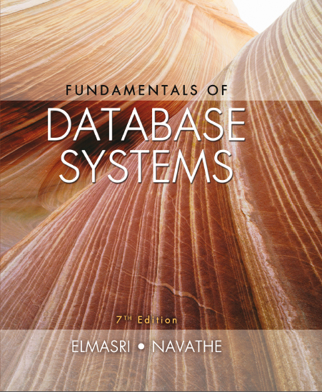
Fundamentals of Database Systems
Seventh Edition
Chapter 11
Web Database Programming Using P H P
Slides in this presentation contain hyperlinks. JAWS users should be able to get a list of links by using INSERT+F7
Copyright © 2016, 2011, 2007 Pearson Education, Inc. All Rights Reserved
Notes:
If this PowerPoint presentation contains mathematical equations, you may need to check that your computer has the following installed:
1) MathType Plugin
2) Math Player (free versions available)
3) NVDA Reader (free versions available)

Slide 2
Learning Objectives
11.1 A Simple P H P Example
11.2 Overview of Basic Features of P H P
11.3 Overview of P H P Database Programming

Slide 3
Web Database Programming Using P H P
Techniques for programming dynamic features into Web
P H P
Open source scripting language
Interpreters provided free of charge
Available on most computer platforms

Slide 4
A Simple P H P Example (1 of 5)
P H P
Open source general-purpose scripting language
Comes installed with the UNIX operating system

Slide 5
A Simple P H P Example (2 of 5)
D B M S
Bottom-tier database server
P H P
Middle-tier Web server
H T M L
Client tier

Slide 6
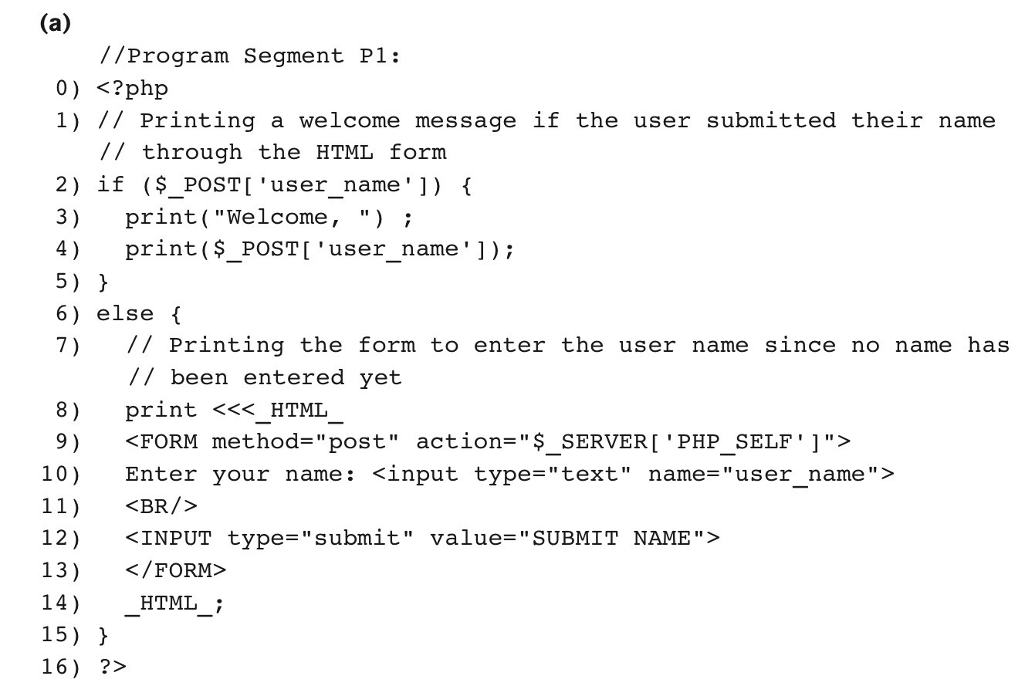
Figure 11.1a P H P Program Segment for Entering a Greeting

Slide 7
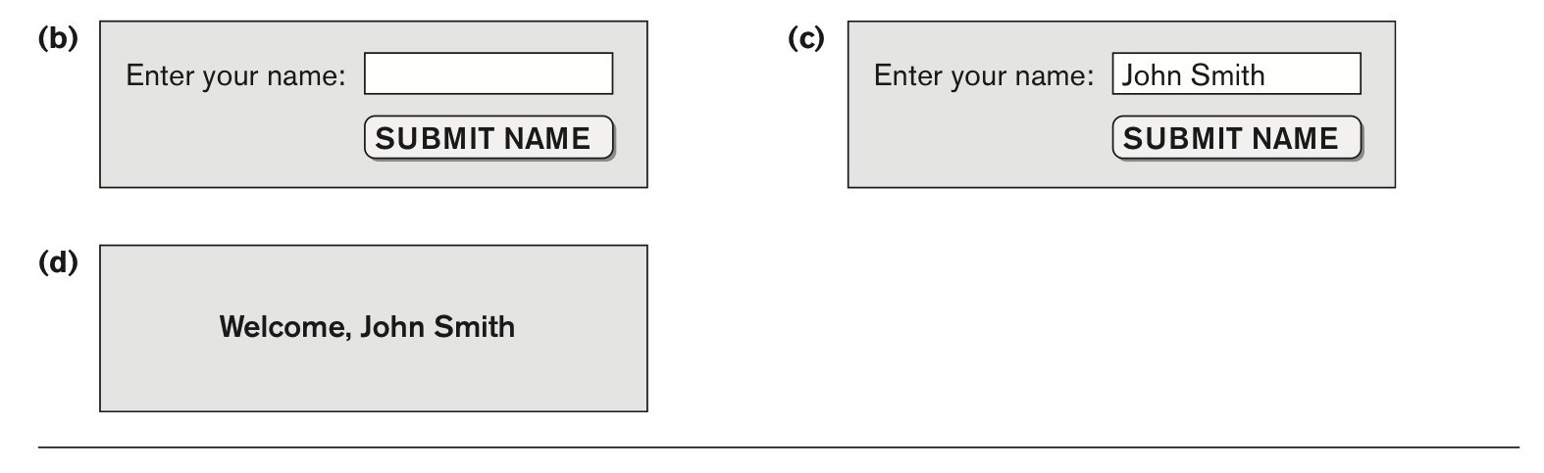
Figure 11.1b-d (b) Initial Form Displayed by P H P Program Segment. (c) User Enters Name John Smith. (d) Form Prints Welcome Message for John Smith

Slide 8
A Simple P H P Example (3 of 5)
Example Figure 11.1(a) (see slide 5)
P H P script stored in:
http://www.myserver.com/example/greeting.php
<?p h p
P H P start tag
?>
P H P end tag
Comments:

Slide 9
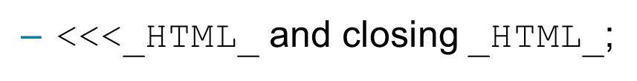
A Simple P H P Example (4 of 5)
$_POST
Auto-global predefined P H P variable
Array that holds all the values entered through form parameters
Arrays are dynamic
Long text strings
Between opening

Slide 10
A Simple P H P Example (5 of 5)
P H P variable names
Start with $ sign

Slide 11
Overview of Basic Features of P H P
Illustrate features of P H P suited for creating dynamic Web pages that contain database access commands

Slide 12
P H P Variables, Data Types, and Programming Constructs (1 of 4)
P H P variable names
Start with $ symbol
Can include characters, letters, and underscore character (_)
Main ways to express strings and text
Single-quoted strings
Double-quoted strings
Here documents
Single and double quotes

Slide 13
P H P Variables, Data Types, and Programming Constructs (2 of 4)
Period (.) symbol
String concatenate operator
Single-quoted strings
Literal strings that contain no P H P program variables
Double-quoted strings and here documents
Values from variables need to be interpolated into string

Slide 14
P H P Variables, Data Types, and Programming Constructs (3 of 4)
Numeric data types
Integers and floating points
Programming language constructs
For-loops, while-loops, and conditional if-statements
Boolean expressions

Slide 15
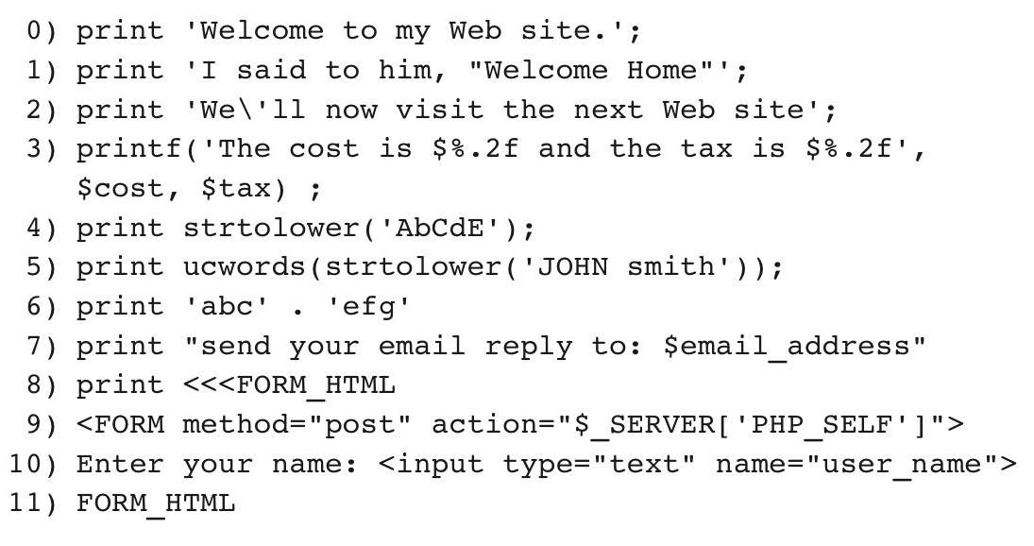
Figure 11.2 Illustrating Basic P H P String and Text Values

Slide 16
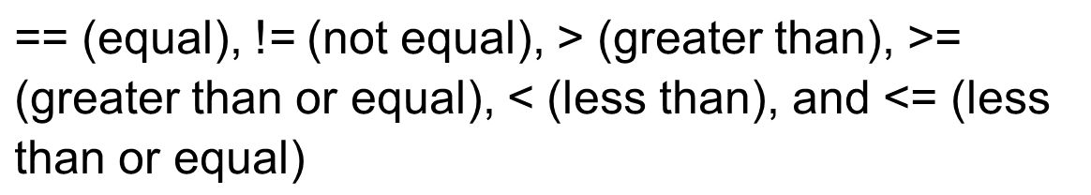
P H P Variables, Data Types, and Programming Constructs (4 of 4)
Comparison operators

Slide 17
P H P Arrays (1 of 3)
Can hold database query results
Two-dimensional arrays
First dimension representing rows of a table
Second dimension representing columns (attributes) within a row
Main types of arrays:
Numeric and associative

Slide 18
P H P Arrays (2 of 3)
Numeric array
Associates a numeric index with each element in the array
Indexes are integer numbers
Start at zero
Grow incrementally
Associative array
Provides pairs of
elements

Slide 19
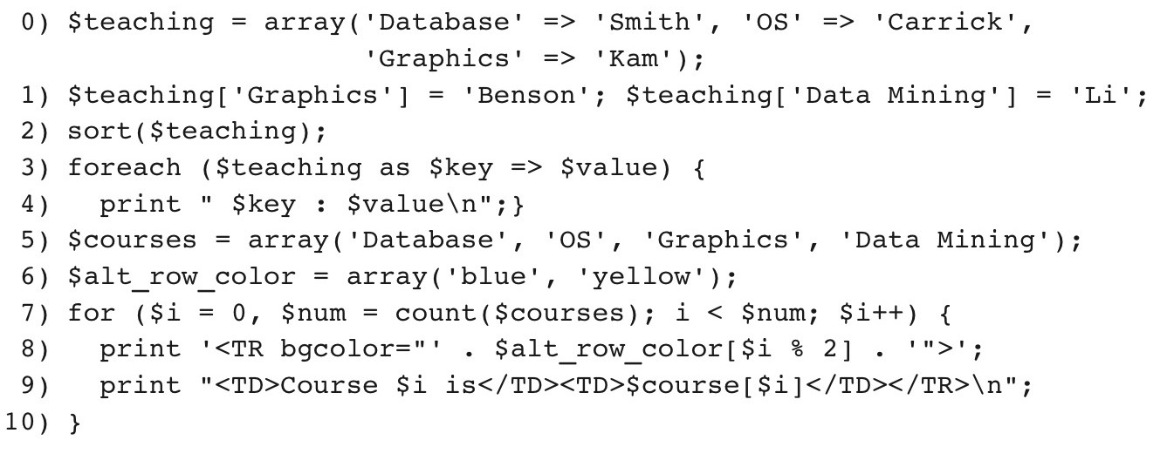
Figure 11.3 Illustrating Basic P H P Array Processing

Slide 20
P H P Arrays (3 of 3)
Techniques for looping through arrays in P H P
Count function
Returns current number of elements in array
Sort function
Sorts array based on element values in it

Slide 21
P H P Functions
Functions
Define to structure a complex program and to share common sections of code
Arguments passed by value
Examples to illustrate basic P H P functions
Figure 11.4 (see slide 22)
Figure 11.5 (see slide 23)

Slide 22
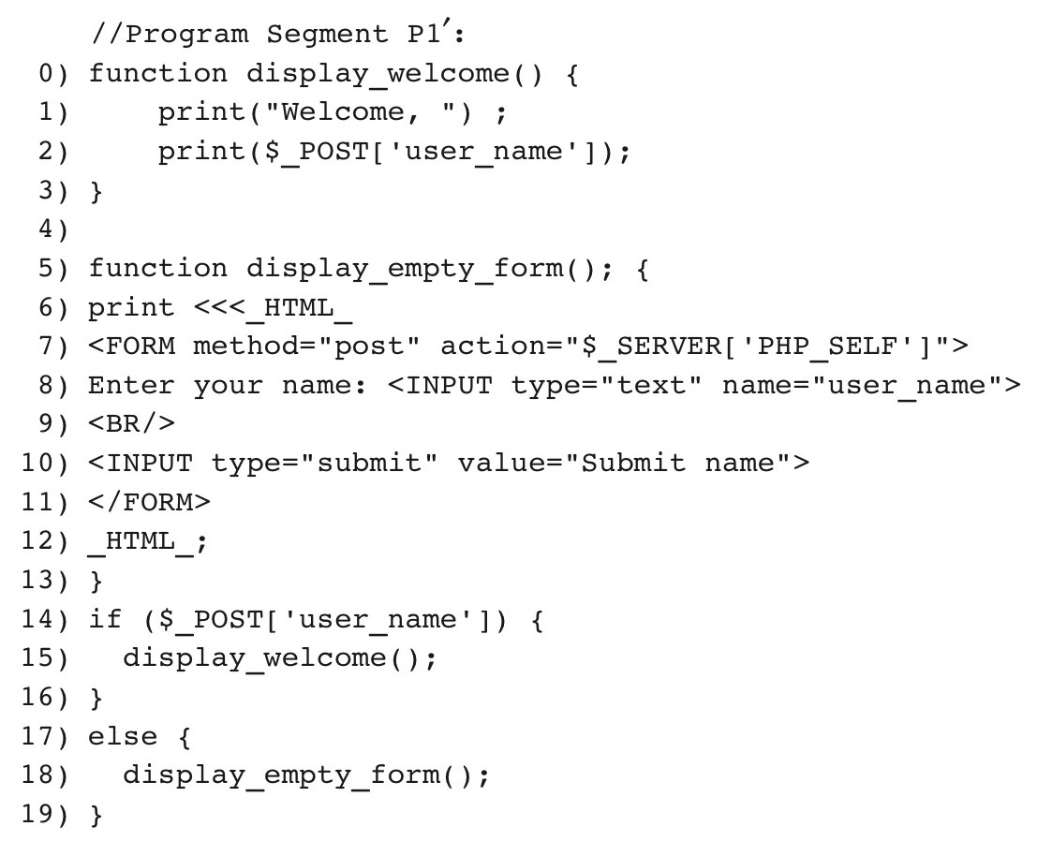
Figure 11.4 Rewriting Program Segment P1 as P1’ Using Functions

Slide 23
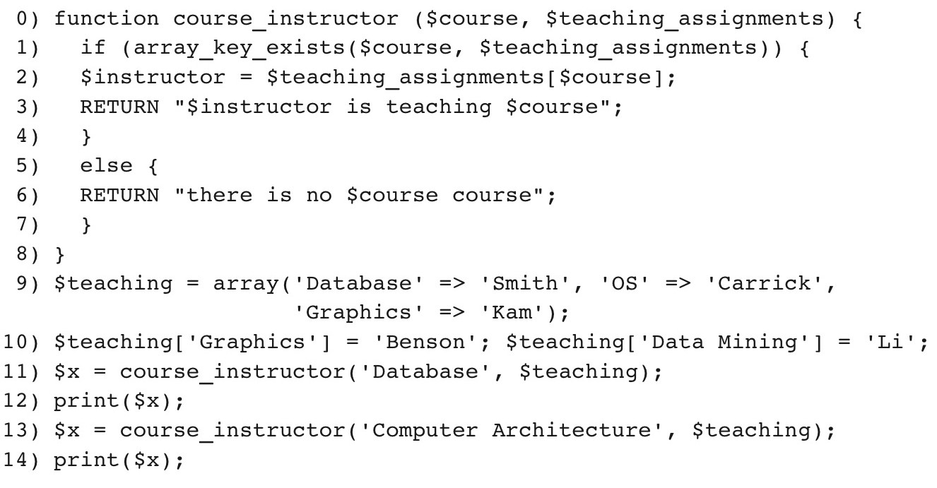
Figure 11.5 Illustrating a Function with Arguments and Return Value

Slide 24
P H P Server Variables and Forms (1 of 2)
Built-in entries
$_SERVER auto-global built-in array variable
Provides useful information about server where the P H P interpreter is running

Slide 25
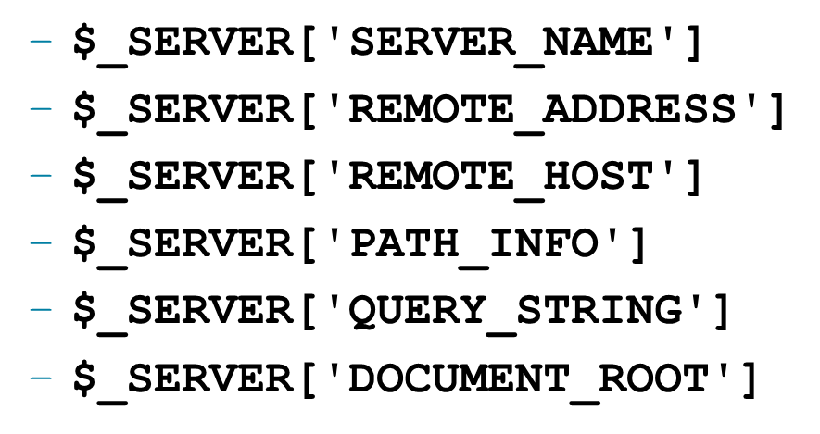
P H P Server Variables and Forms (2 of 2)
Examples:
,
,
,
,
,
,
$_POST
Provides input values submitted by the user through H T M L forms specified in <INPUT> tag

Slide 26
Overview of P H P Database Programming
PEAR D B library
Part of P H P Extension and Application Repository (PEAR)
Provides functions for database access

Slide 27
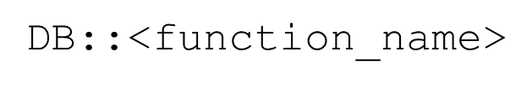
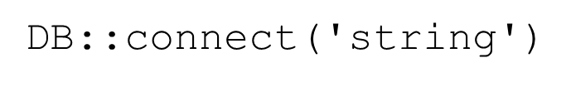
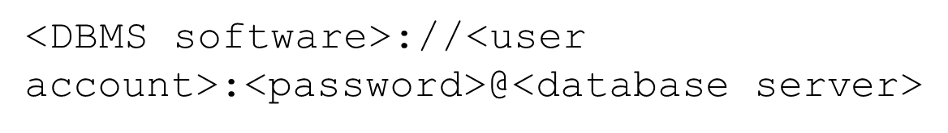
Connecting to a Database
Library module D B.p h p must be loaded
DB library functions accessed using
Function for connecting to a database
Format for 'string' is:

Slide 28
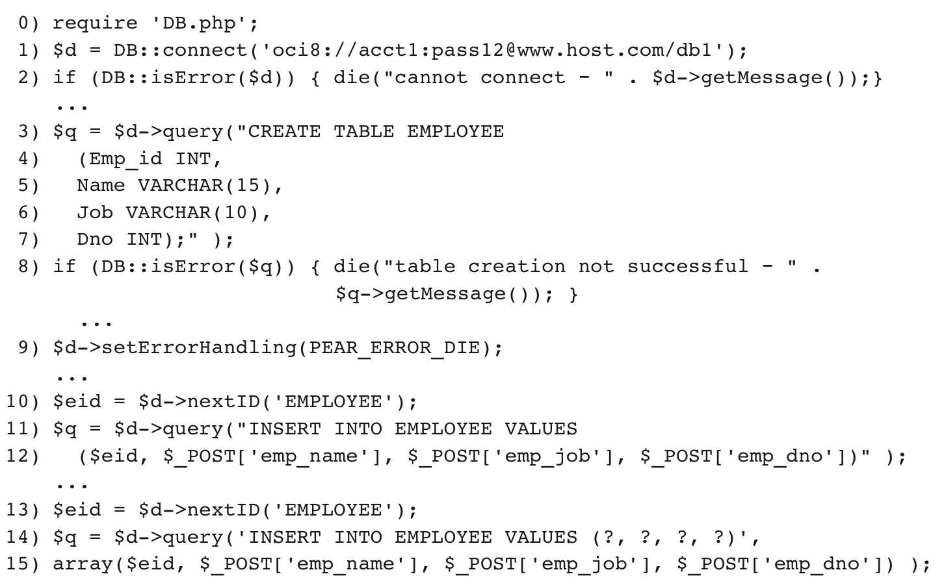
Figure 11.6 Connecting to a Database, Creating a Table, and Inserting a Record

Slide 29
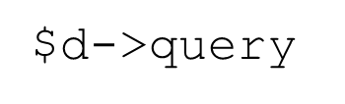
Some Database Functions
Query function
takes an S Q L command as its string argument
Sends query to database server for execution
Terminate program and print default error messages if any subsequent errors occur

Slide 30
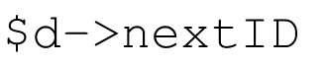
Collecting Data from Forms and Inserting Records
Collect information through H T M L or other types of Web forms
Create unique record identifier for each new record inserted into the database
P H P has a function
to create a sequence of unique values for a particular table
Placeholders
Specified by ? symbol

Slide 31
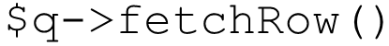
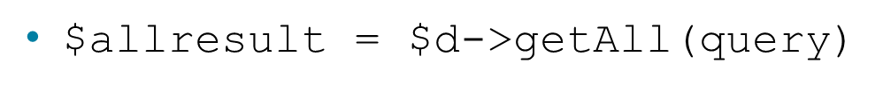
Retrieval Queries from Database Tables
$q
Variable that holds query result
retrieve next record in query result and control loop
Holds all the records in a query result in a single variable called $allresult

Slide 32
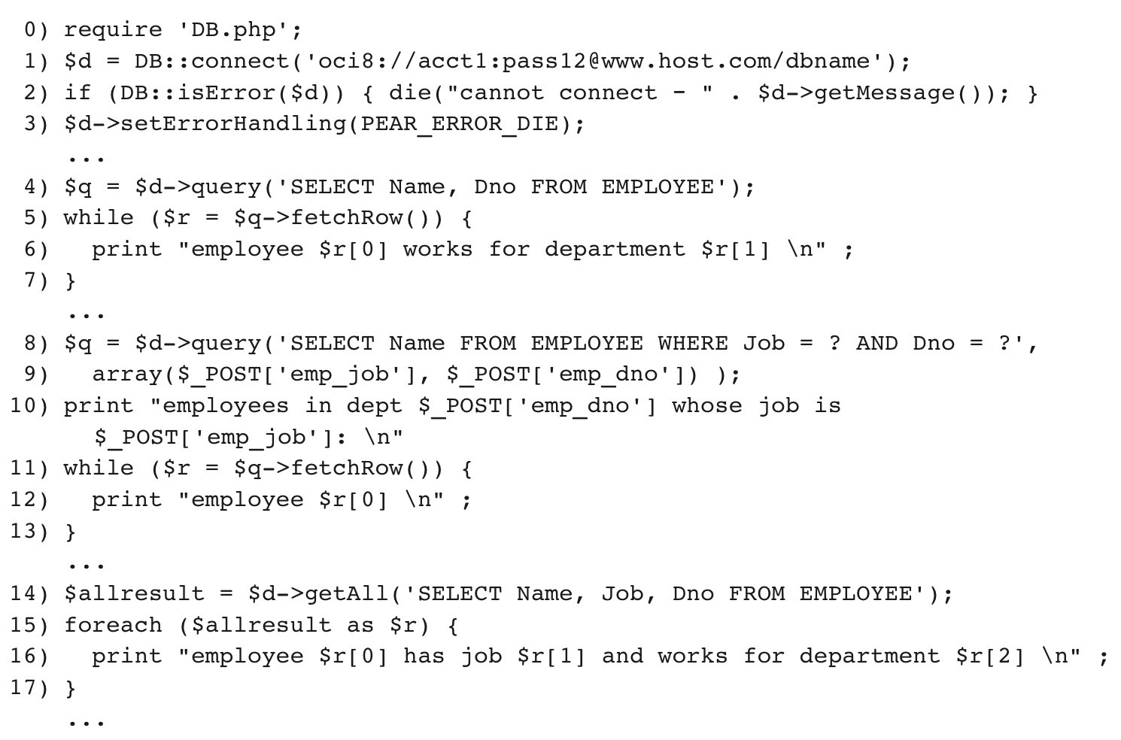
Figure 11.7 Illustrating Database Retrieval Queries

Slide 33
Other Techniques (1 of 2)
P H P runs on server
Sends H T M L to client
Many other languages/technologies for Web D b programming
Examples:
Java servlets:
Java objects on server, interact with client
Store information about interaction session

Slide 34
Other Techniques (2 of 2)
Java Server Pages (J S P)
Creates dynamic Web pages through scripting at server to send to client (somewhat like P H P)
JavaScript
Scripting language, can run at client or server
Java Script Object Notation (J S O N):
Text-based representation of objects
Similar function to X M L
Used in many N O S Q L systems

Slide 35
Summary
P H P scripting language
Very popular for Web database programming
P H P basics for Web programming
Data types
Database commands include:
Creating tables, inserting new records, and retrieving database records
Looping over a query result

Slide 36

Copyright

